Slide 1
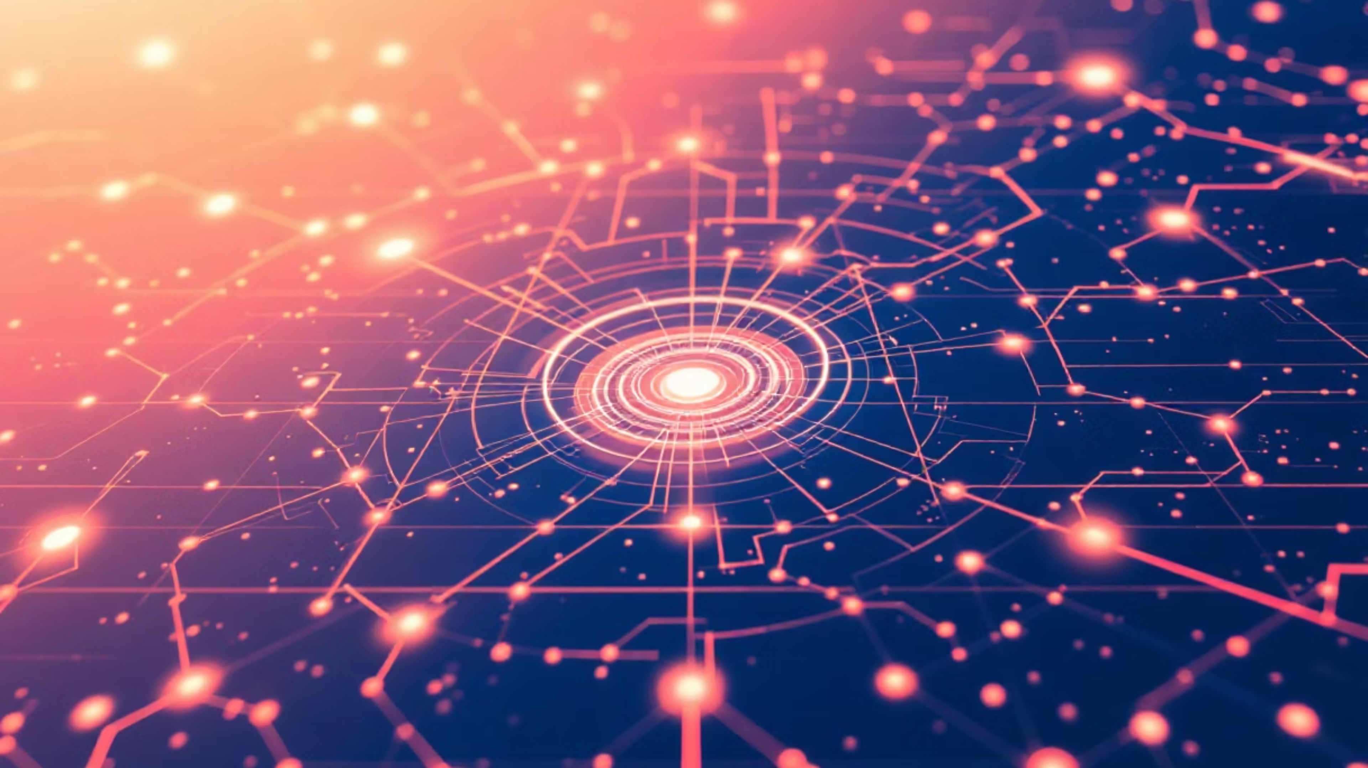
The Future is Sensing: Sensors in Healthcare and Agriculture
This document explores the wide spectrum of sensors transforming healthcare and agriculture. From wearable monitors that deliver personalised care to soil probes that squeeze more yield from every litre of water, sensing technologies are the invisible engines of efficiency, safety and sustainability. The palette of innovations ranges from non‑invasive optical sensors and biosensors to rugged environmental probes and animal‑worn trackers.

Slide 2

Introduction to Sensor Technology and its Impact
Sensors convert physical, chemical or biological information into data. They form networks — from single‑point wearable devices to distributed IoT arrays — enabling realtime decision making. In healthcare they inform diagnostics, remote monitoring and clinical workflows. In agriculture they drive precision farming: targeted irrigation, nutrient delivery and pest control that reduce waste and increase resilience.
Key attributes: sensitivity, specificity, power efficiency, connectivity.
Common interfaces: Bluetooth, LoRaWAN, NB‑IoT and wired industrial links.
Cross‑sector value: predictive analytics, automated alerts, regulatory compliance.
Design note: prioritise low power and secure transmission in both domains to protect privacy and ensure continuous operation in remote areas.

Slide 3



Sensors in Healthcare: Revolutionising Diagnostics and Monitoring
Medical sensors span from bedside pulse oximeters to lab‑grade biosensors that detect biomarkers at molecular levels. They shorten diagnostic timelines, allow continuous monitoring of chronic conditions and support telemedicine. High‑accuracy sensors enable early detection of deterioration and empower clinicians with longitudinal patient data.
Cardiac & Respiratory
Biosensors
Temperature & Chemical
ECG pads, pulse oximeters and respiratory effort sensors for acute and chronic care.
Glucose strips, immunoassays and point‑of‑care molecular sensors for rapid diagnostics.
Contact and thermal imaging sensors; chemical sensors for drug levels and biomarkers.

Slide 4



Wearable Sensors: Continuous Health Tracking and Early Intervention
Wearables capture continuous physiological signals — heart rate variability, activity, sleep stages, skin temperature and sweat chemistry. They enable early intervention by detecting deviations from personal baselines and by feeding AI models that predict exacerbations or silent events. Their form factors range from discreet patches to smart textiles and consumer smartwatches adapted for clinical use.
Smartwatches
Adhesive Patches
Smart Textiles
ECG, PPG and accelerometry for arrhythmia detection and mobility assessment.
Continuous glucose or multi‑analyte patches for discreet long‑term monitoring.
Embedded threads sensing respiration, posture and muscle activity for rehabilitation.

Slide 5


Implantable and Ingestible Sensors: Internal Monitoring and Drug Delivery
Implantable sensors provide high‑fidelity internal data — intracranial pressure, neural activity and blood chemistry — while ingestible capsules traverse the GI tract collecting local measurements. Coupled with micro‑actuation, these platforms can release drugs or adjust therapy dynamically. Their design challenges include biocompatibility, long‑term stability and secure telemetry.
Ingestible Capsules
Cardiac & Neural Implants
GI environment sensing and targeted drug release for diagnostics and therapy.
Pacemakers, neurostimulators and intracranial pressure monitors with telemetry.

Slide 6

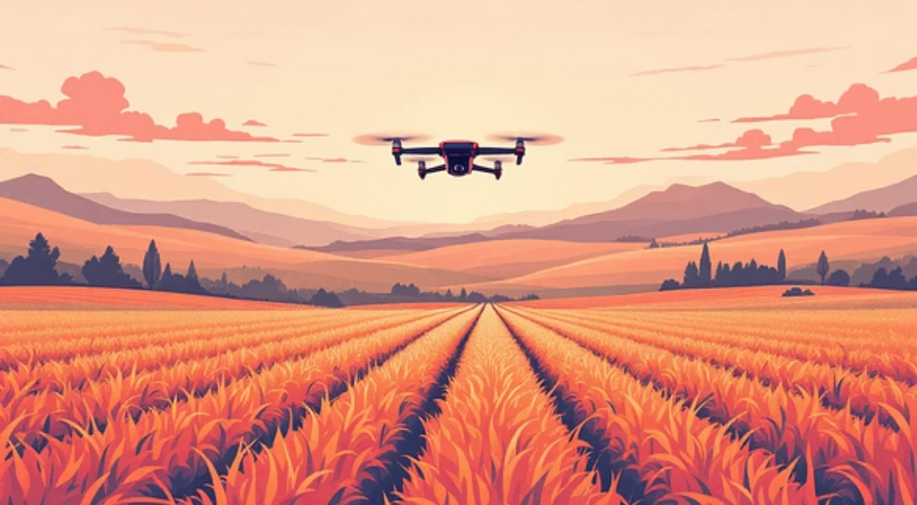

Sensors in Agriculture: Precision Farming and Resource Optimisation
Agricultural sensors enable precision application of water, fertiliser and pesticides — reducing inputs and environmental impact while improving yield. Sensors feed decision support systems that schedule irrigation, detect stress and map variability across fields. Integration with drones and autonomous machinery creates a feedback loop of sensing, analysis and targeted action.

Slide 7
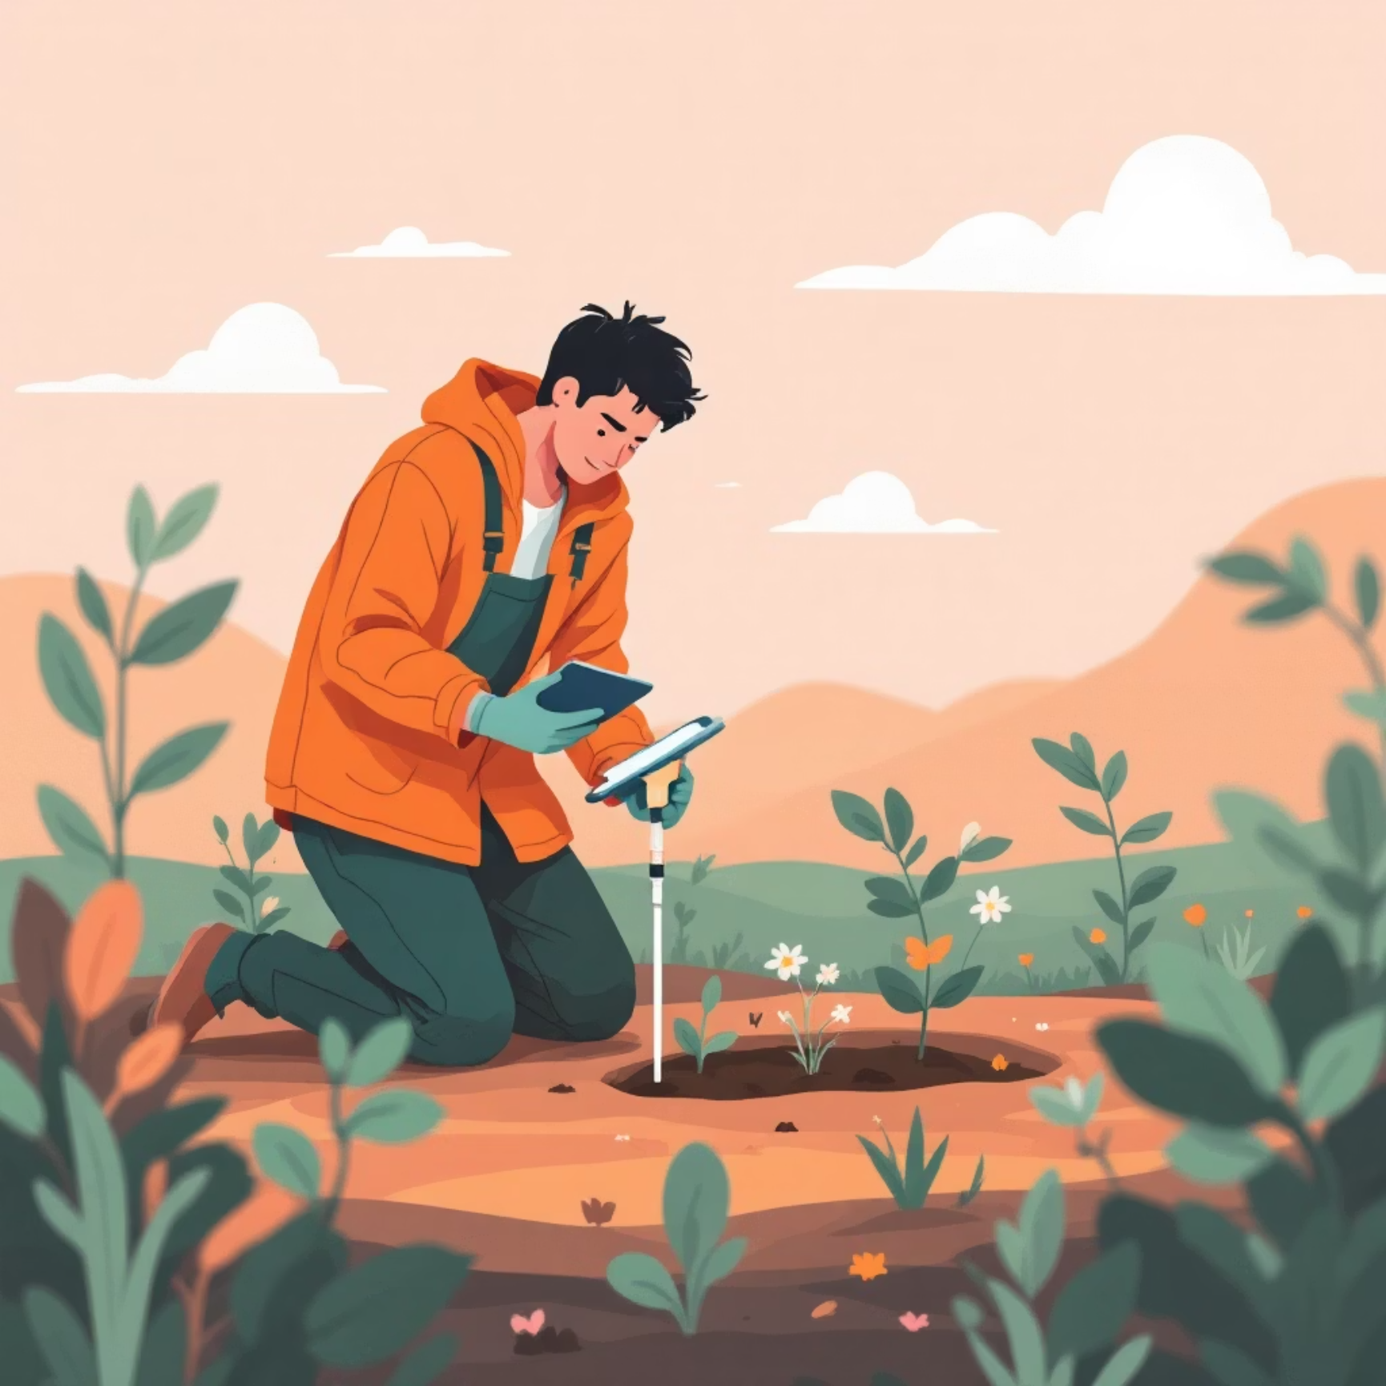


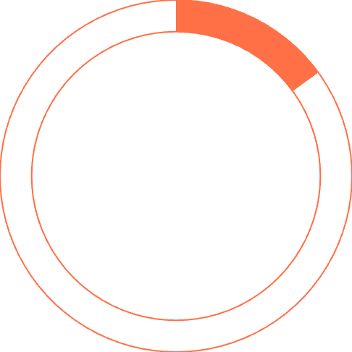
Soil and Environmental Sensors: Maximising Crop Yield and Sustainability
Soil probes measure moisture, temperature, electrical conductivity and nutrient levels. Environmental sensors capture microclimate data — temperature, humidity, radiation, wind and leaf wetness — essential for disease risk models and irrigation scheduling. When combined with spatial mapping, farmers treat only the areas that need attention, conserving water and fertiliser.
40%
Water savings with targeted irrigation
25%
Reduction in fertiliser usage
15%
Lower pesticide application
Best practice: pair in‑soil sensors with weather forecasts and evapotranspiration models to set irrigation thresholds that respond to crop stage and soil texture.

Slide 8


Livestock Monitoring Sensors: Animal Health and Welfare Management
Animal‑mounted sensors — collars, ear tags and boluses — track location, rumination, temperature and activity. Early detection of illness, heat stress or lameness improves welfare and productivity while enabling traceability across the supply chain. Sensors also support breeding programmes via oestrus detection and optimise feeding through automated systems.
Collars & Tags
Ear Tags & Boluses
Continuous vitals and geo‑fencing for grazing management and disease alerts.
Internal temperature and rumen sensors for health and digestion monitoring.

Slide 9



Emerging Trends and Future Applications of Sensor Technology
Future directions include nanobiosensors for single‑molecule detection, ubiquitous low‑cost sensors enabling hyperlocal environmental networks, and federated learning to preserve privacy while improving models. Convergence with edge computing and energy‑harvesting techniques will allow sensors to operate autonomously for years, unlocking applications in remote healthcare delivery and autonomous farming.
Edge AI
1
On‑device inference for latency‑sensitive alerts.
Energy Harvesting
2
Solar and kinetic power to extend lifetime in the field or body.
Secure Federated Learning
3
Shared models without sharing raw patient or farm data.

Slide 10
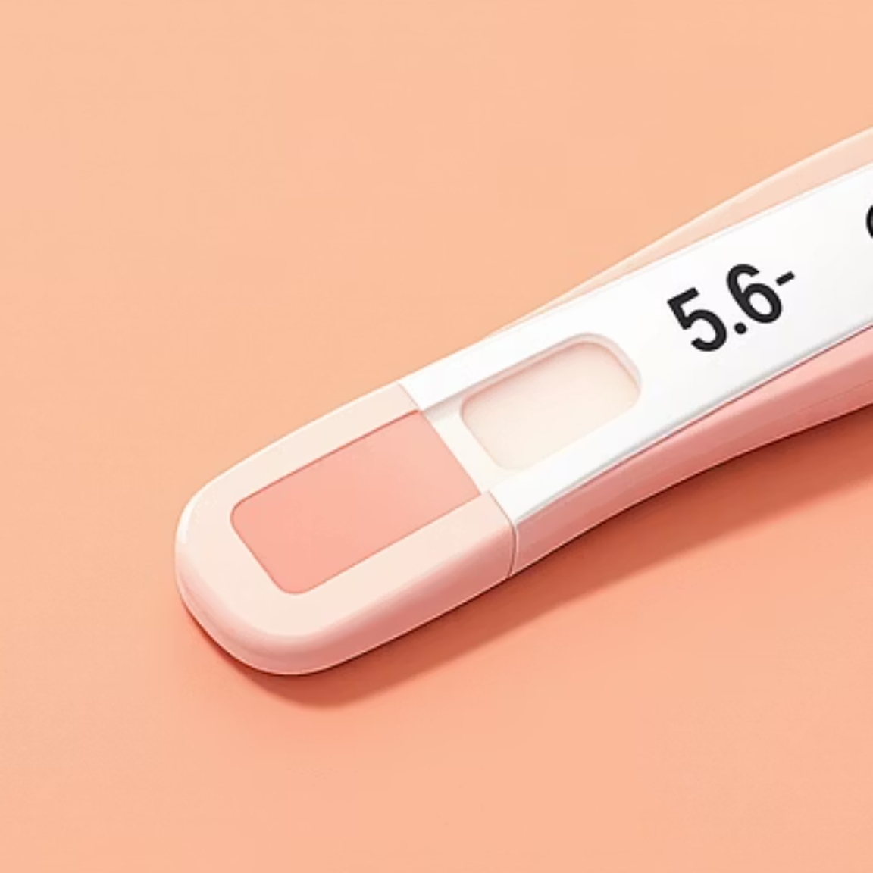


Conclusion: The Transformative Power of Sensors in Key Industries
Sensors are catalysts for smarter, more sustainable healthcare and agriculture. They shift systems from reactive to proactive by delivering continuous, actionable insights. Realising this promise requires robust engineering, ethical data stewardship and cross‑discipline collaboration to ensure technologies are reliable, inclusive and beneficial at scale.
Recommendation: prioritise interoperable standards, secure connectivity and human‑centred design so sensor ecosystems serve people, animals and the planet effectively.

